Slide 1

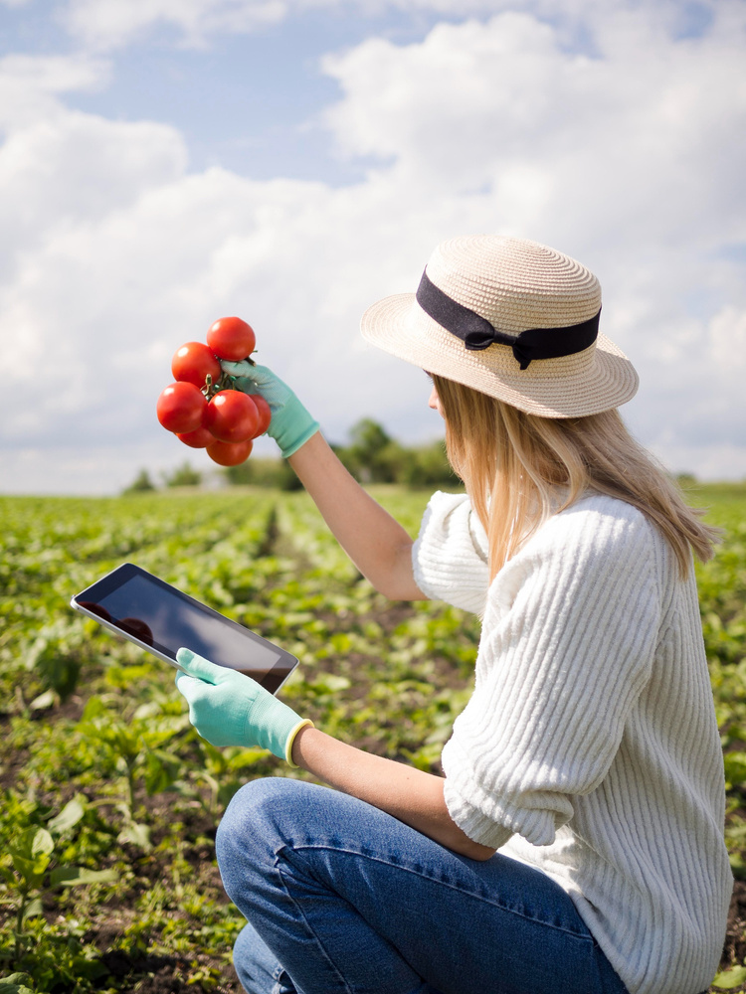




Proposal Presentation
AGROFARMA
24-25J-193 | AI-Based Data-Driven Agriculture System
Sri Lanka Institute of Information Technology

Slide 2


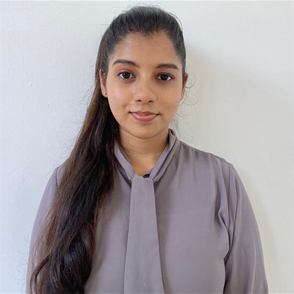
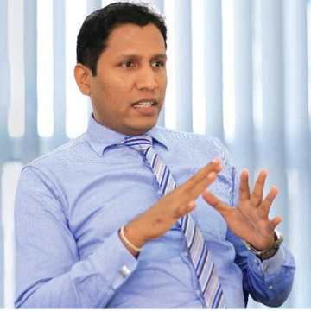
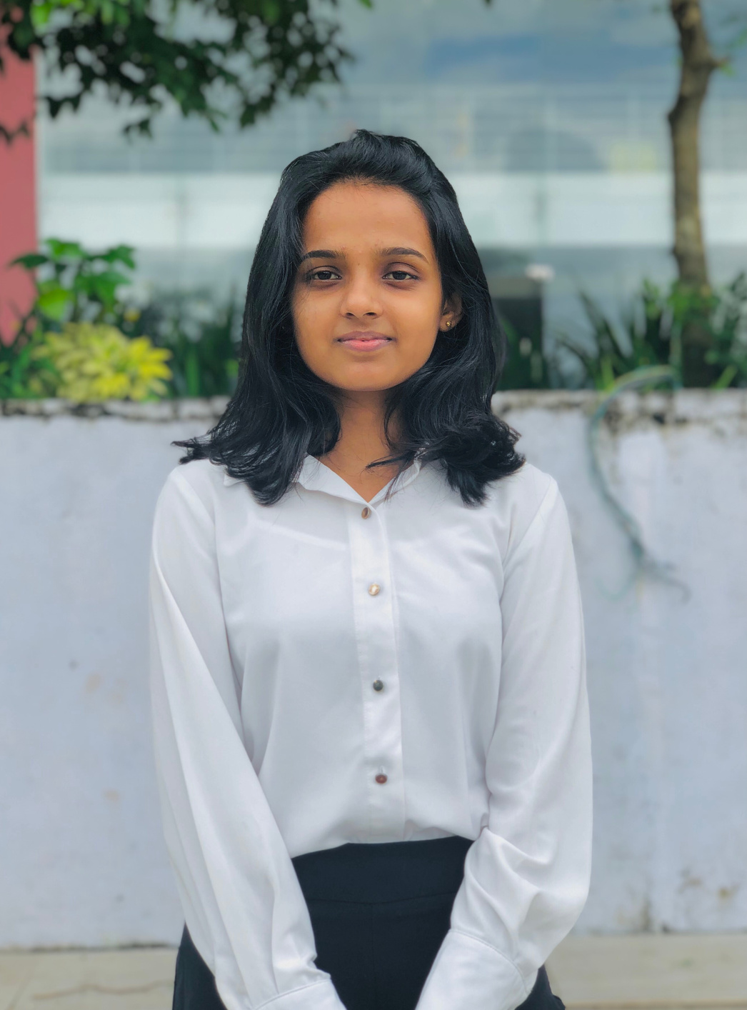

Our Team Members
Dissanayake D M A P
Leader - IT21158490
Faculty of Computing - IT
Prof. Pradeep Abeygunawardhane
Supervisor
Dean - Faculty of Computing
Professor / Computer System Engineering
SLIIT
Priyankara S A D S A
Member 2 - IT21172632
Faculty of Computing - IT
Didula Chamara Thanweera Arachchi
Co-Supervisor
Sewwandi P B
Member 3 - IT21171956
Faculty of Computing - IT
Lecturer in IM and Digital Marketing,
Department of CS and SE,
Faculty of Computing | SLIIT
Jagoda H S
Member 4 - IT21171956
Faculty of Computing - IT
Sri Lanka Institute of Information Technology

Slide 3
Introduction
Agriculture, despite being a trade that has been consistent since a long time ago, is among the few industries that are at a large risk due to how easily uncontrollable factors can affect its main produce; crops.
While some of these cannot be precisely avoided, other challenges such as fluctuating market prices, unpredictable weather patterns, and the need for sustainable prices can be addressed through the integration of technology in agriculture to:
Enhance productivity
Ensure Sustainability
Support Farmers in decision-making.

Slide 4
Research Problem
Core Issues
Inconsistent market prices
Weather unpredictability
Inadequate Crop Growth Insights
Limited Decision Support
Maintaining sustainable farming practices
These challenges leads to farmers being hindered in their ability to make informed decisions, ultimately leading to inefficiencies, reduced profitability, and increased risk in agricultural production.

Slide 5

Proposed Solution
An AI-driven platform designed to support farmers by providing data-driven predictions and tailored recommendations.
This system will assist farmers in predicting market trends, optimizing crop growth, and ensuring sustainable practices through:
AgriProfitPredict
Comprehensive Price and Profit Prediction System
AgriGrowth Analysis Predictor
CropWise
Decision Support System for Crop Recommendation
Personalized Agri Assistant

Slide 6
Main Goal
To create a comprehensive web-based platform that empowers farmers with timely, accurate and practical insights along with the tools necessary to act on them, resulting in maximized crop yield, profitability, and overall agricultural success.
Objectives
Predict market prices to help farmers plan better.
Crop viability analysis to assess crop growth rates for optimal harvesting times.
Give tailored crop recommendations crops to farmers to ensure sustainable farming practices.
Provide personalized farming advice through an interactive AI assistant.

Slide 7
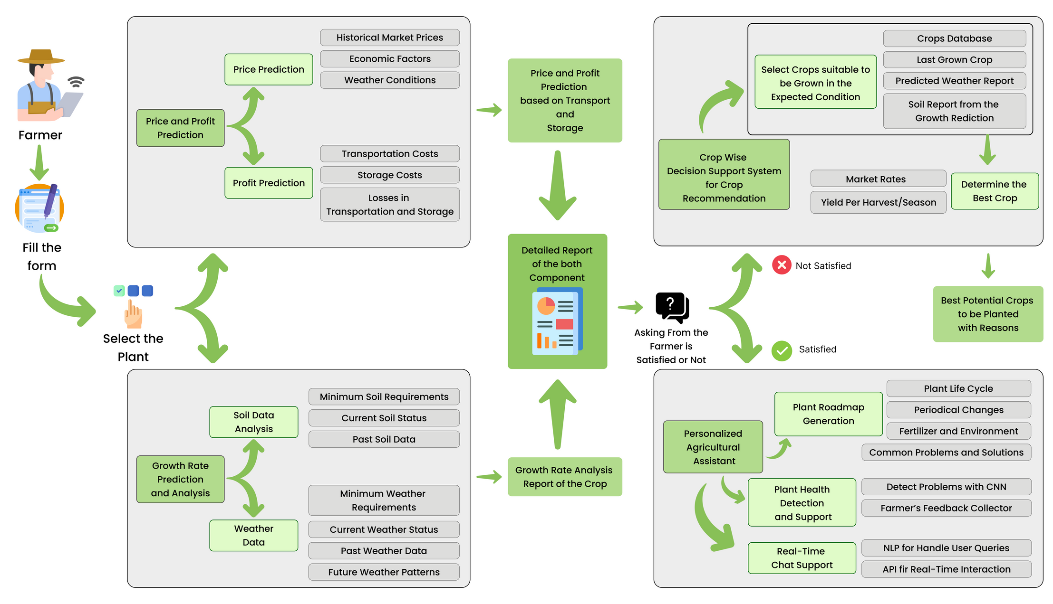
Architectural Diagram

Slide 8
Component 01
Priyankara S A D S A
IT21172632
AgriProfitPredict
Comprehensive Price and Profit Prediction System
Priyankara S A D S A | IT21172632 | 24-25J-193

Slide 9
Introduction
Background:
Farmers face significant challenges in optimizing profits due to fluctuating market prices, high transportation costs, and losses during storage.
Research Focus:
This study introduces an innovative approach that combines market price forecasting with detailed profit and loss analysis, tailored to different transportation modes and storage conditions.
Priyankara S A D S A | IT21172632 | 24-25J-193

Slide 10
Problem
Core Issue:
Farmers often face financial losses due to ineffective storage methods and poor transportation choices, which can result in spoilage, increased costs, and reduced profit margins.
Priyankara S A D S A | IT21172632 | 24-25J-193

Slide 11
Main Objective
To introduce an innovative model that integrates crop price forecasting with profit and loss analysis based on transportation modes and storage conditions.
Sub - Objectives
To enhance decision-making for farmers
To optimize profit margins
To reduce financial risks
To improve supply chain efficiency
Priyankara S A D S A | IT21172632 | 24-25J-193

Slide 12
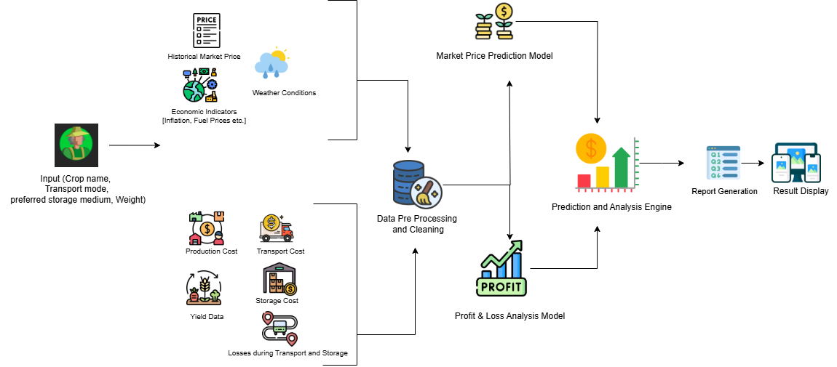
System Diagram
Priyankara S A D S A | IT21172632 | 24-25J-193

Slide 13
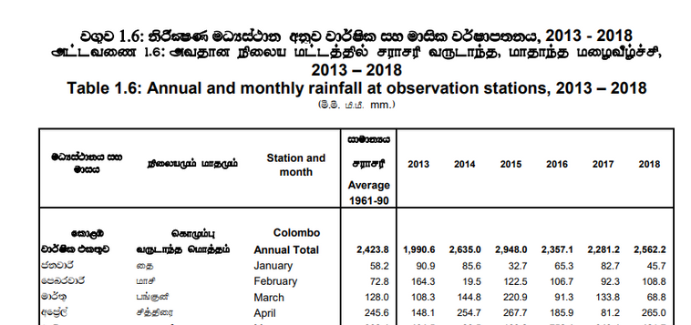
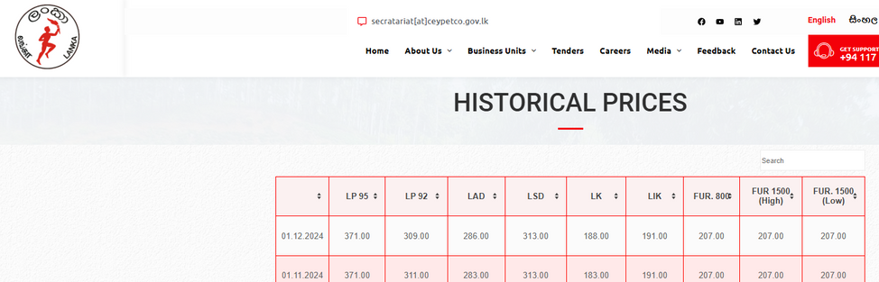
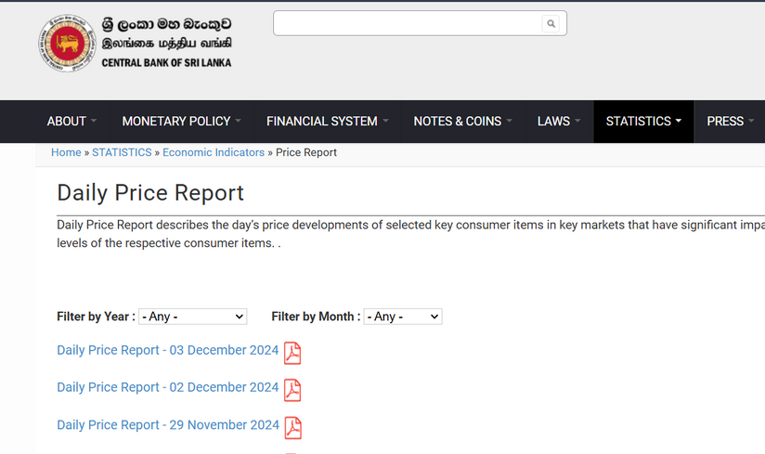
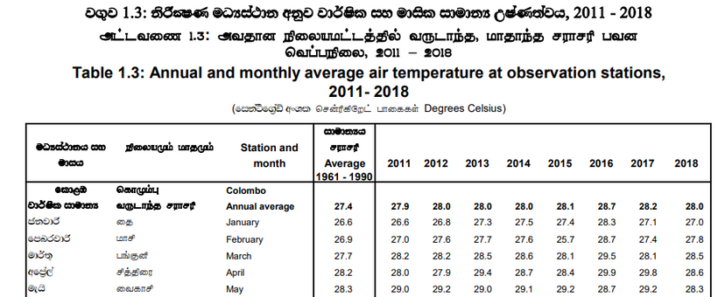
DATA COLLECTION
DATA COLLECTION
Department Of Census And Statistics
Priyankara S A D S A | IT21172632 | 24-25J-193

Slide 14
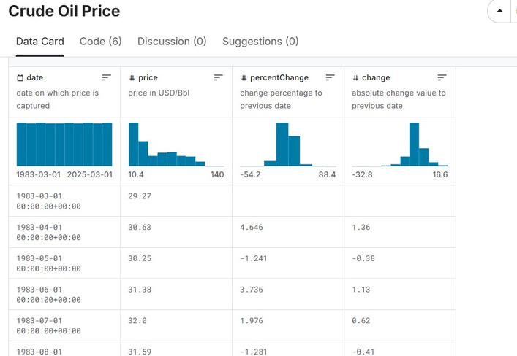
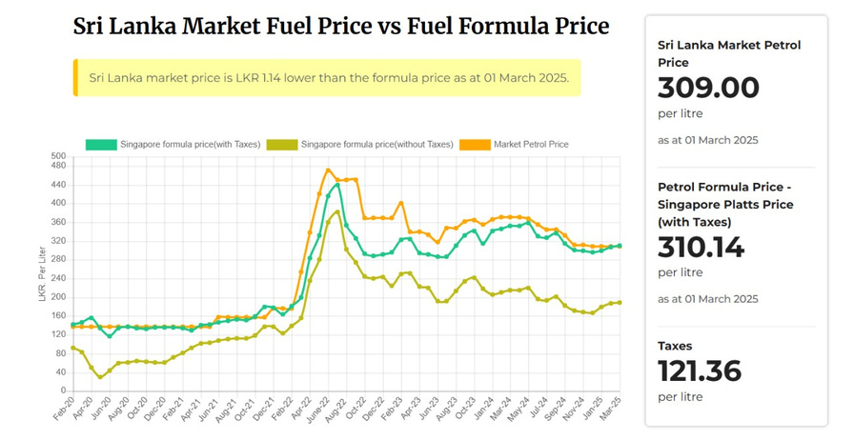
DATA COLLECTION
https://dashboards.publicfinance.lk/fuel-price-tracker/
https://www.kaggle.com/datasets/sc231997/crude-oil-price
Priyankara S A D S A | IT21172632 | 24-25J-193

Slide 15
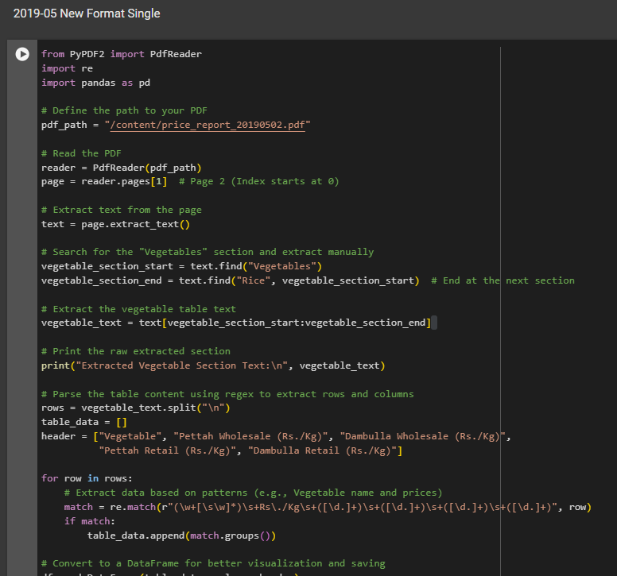
DATA COLLECTION
DATA EXTRACTION
Priyankara S A D S A | IT21172632 | 24-25J-193

Slide 16
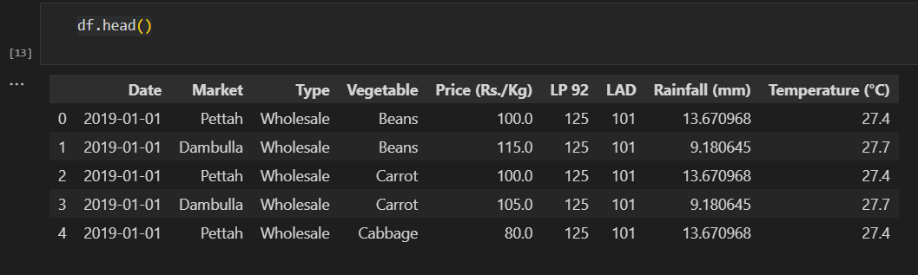
Data Set
Priyankara S A D S A | IT21172632 | 24-25J-193

Slide 17
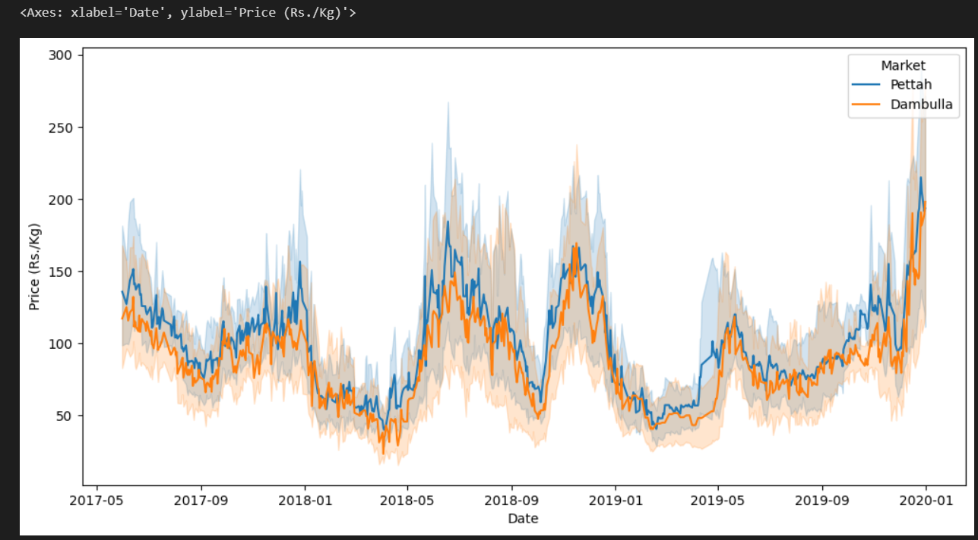
Data Set
Priyankara S A D S A | IT21172632 | 24-25J-193

Slide 18
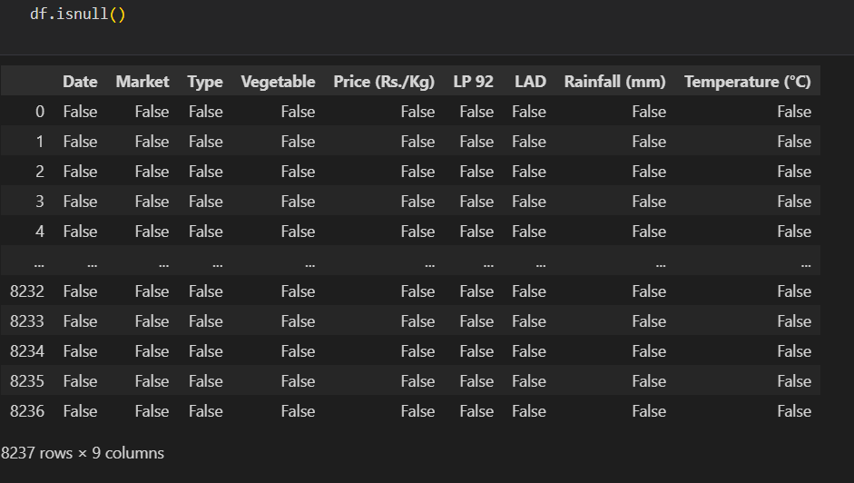
Data Preprocessing
Priyankara S A D S A | IT21172632 | 24-25J-193

Slide 19
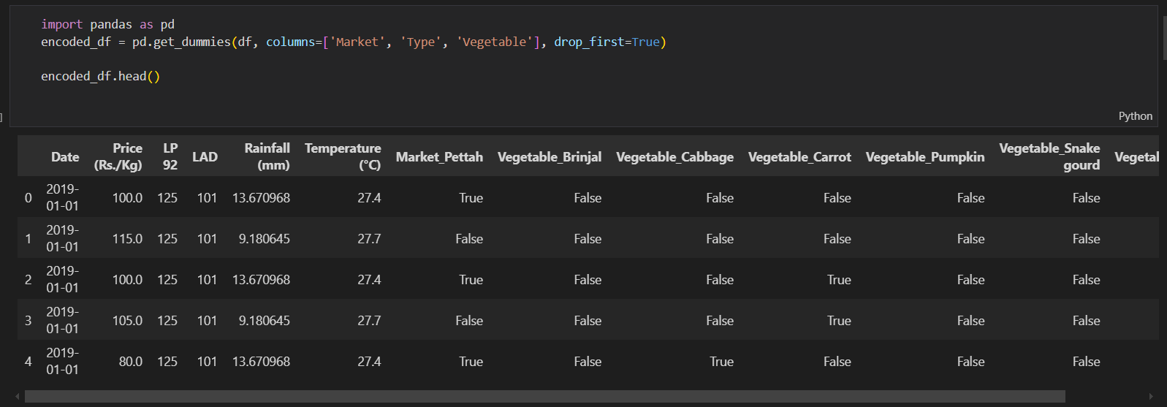
Data Preprocessing
OneOne Hot Encoding
Priyankara S A D S A | IT21172632 | 24-25J-193

Slide 20
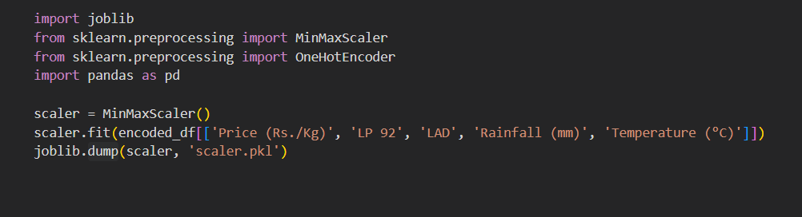
Data Preprocessing
MinMaxScaler
Priyankara S A D S A | IT21172632 | 24-25J-193

Slide 21
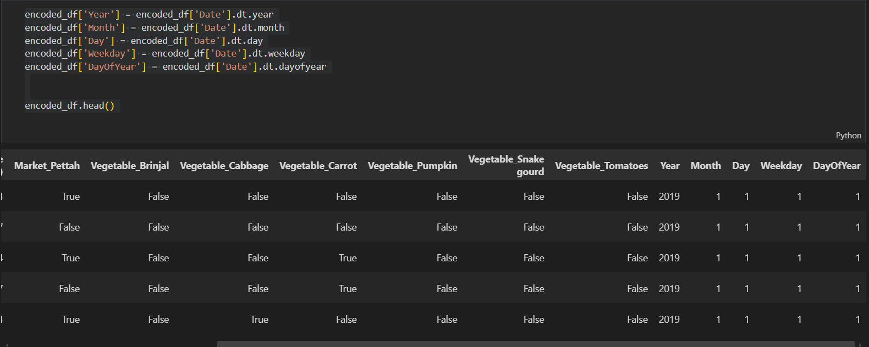
Data Preprocessing
The Date column is split into multiple temporal features
Priyankara S A D S A | IT21172632 | 24-25J-193

Slide 22
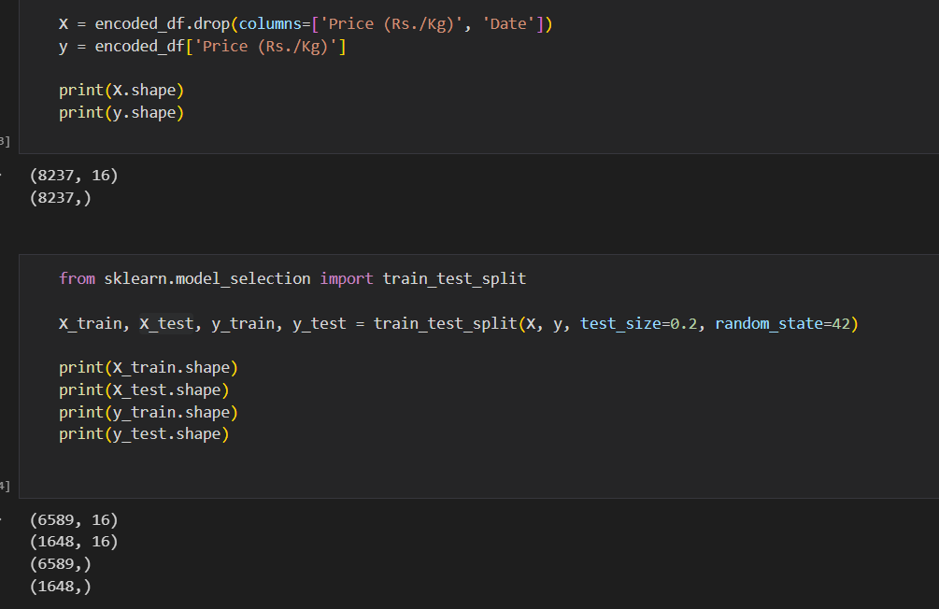
Data Preprocessing
Splitting Data Set
Priyankara S A D S A | IT21172632 | 24-25J-193

Slide 23
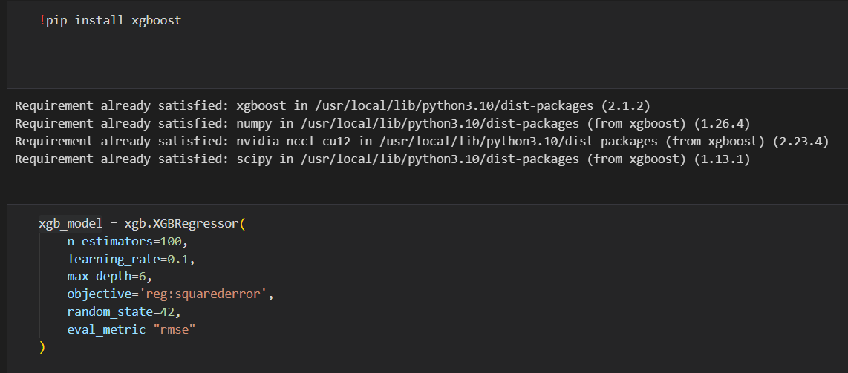
Model Creation and Training
Priyankara S A D S A | IT21172632 | 24-25J-193

Slide 24
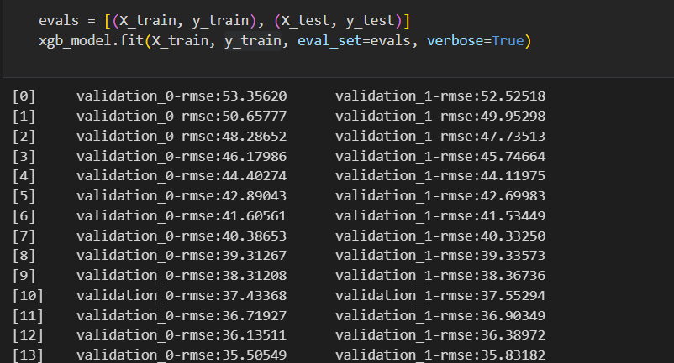
Model Creation and Training
Priyankara S A D S A | IT21172632 | 24-25J-193

Slide 25
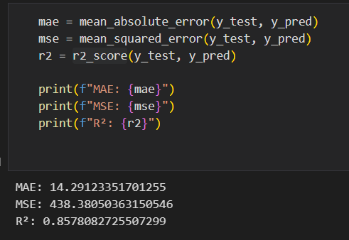
Model Performance and Comparison
Accuracy 85%
Priyankara S A D S A | IT21172632 | 24-25J-193

Slide 26
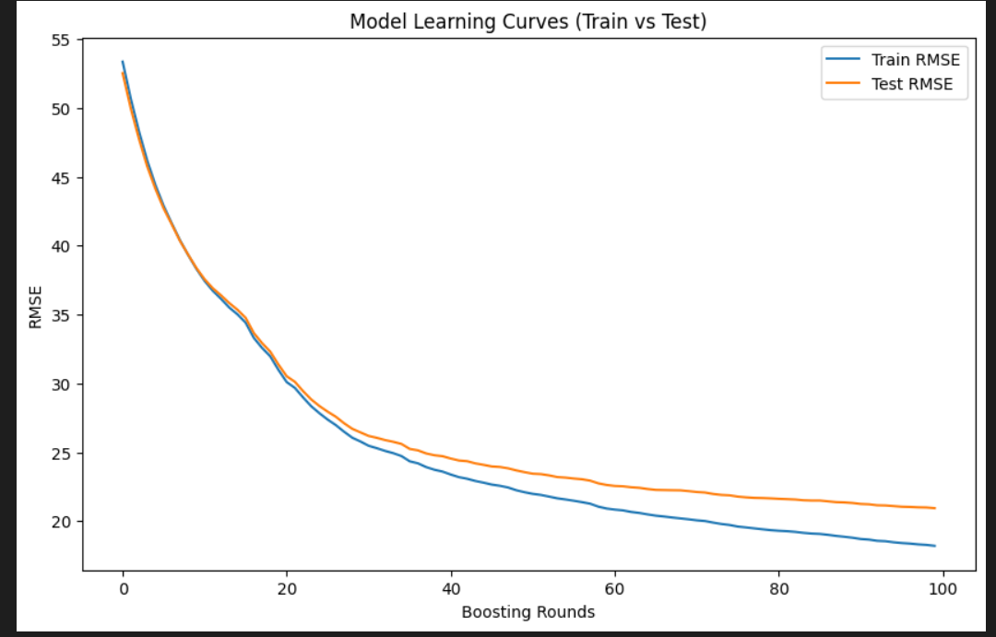
Model Performance and Comparison
Priyankara S A D S A | IT21172632 | 24-25J-193

Slide 27
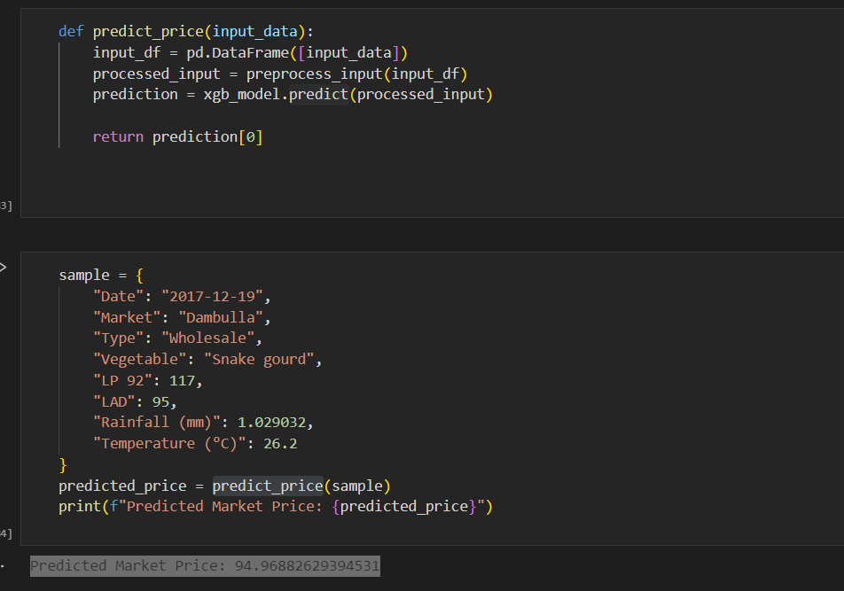
Testing
Priyankara S A D S A | IT21172632 | 24-25J-193

Slide 28
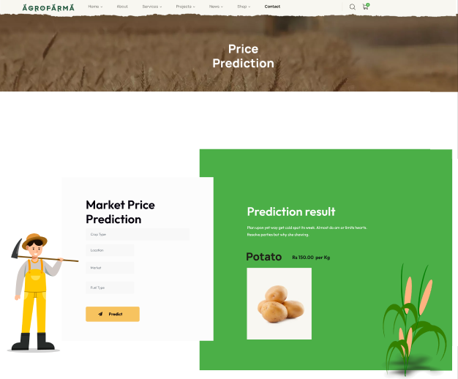
UI
Market Price Prediction
Priyankara S A D S A | IT21172632 | 24-25J-193

Slide 29
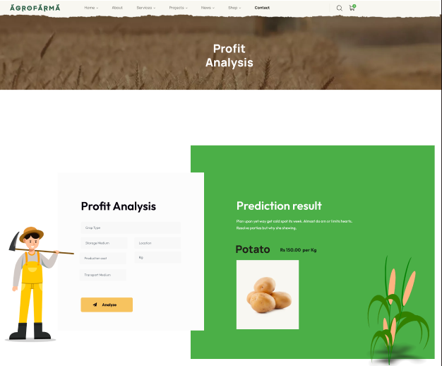
UI
Profit Analyze
Priyankara S A D S A | IT21172632 | 24-25J-193

Slide 30

DEMONSTRATION
Priyankara S A D S A | IT21172632 | 24-25J-193

Slide 31
Technologies to be Used
Price Forecasting:
XGBoost.
Backend Development
Flask
Profit and Loss Analysis:
Linear Regression.
Random Forest
APIs for Data Collection:
Google Maps API
Weather APIs (e.g., OpenWeatherMap)
Data Analytics Tools:
Python or R
Priyankara S A D S A | IT21172632 | 24-25J-193

Slide 32
References
[1] R. Gamage, A. Sangeeth, J. L. Wijekoon, H. Rajapaksa, G. Hemachandra, and D. Nawinna, "Smart Agriculture Prediction System for Vegetables Grown in Sri Lanka," in *Proc. IEEE IEMCON 2021*, Vancouver, BC, Canada, Oct. 2021, pp. 1-7. [Online]. Available: https://www.researchgate.net/publication/356826715_Smart_Agriculture_Prediction_System_for_Vegetables_Grown_in_Sri_Lanka. DOI: 10.1109/IEMCON53756.2021.9623259
[2] S. M. T. A. Rathnayake, S. Munasinghe, Y. A. Dilhara, R. M. I. D. Rathnayake, and N. Jayasuriya, "Packing and Transporting Procedures Used by Sri Lankan Farmers to Reduce Post-Harvest Losses," in *Proc. 7th CIPM International Research Symposium*, Sri Lanka, June 2023, pp. 606-612. [Online]. Available: https://www.researchgate.net/publication/371377929_Packing_and_Transporting_Procedures_Used_by_Sri_Lankan_Farmers_to_Reduce_Post-Harvest_Losses
[1] K. G. L. R. Jayathunge, W. M. C. B. Wasala, H. M. A. P. Rathnayake, C. R. Gunawardane, H. C. Samarakoon, M. D. Fernando, and K. B. Palipane, "Evaluation of Different Types of Packages for Handling and Transportation of Vegetables," *Sri Lanka Journal of Agricultural Sciences*, vol. 2, no. 1, pp. 1-37, Feb. 2004. [Online]. Available: https://www.researchgate.net/publication/304616896_EVALUATION_OF_DIFFERENT_TYPES_OF_PACKAGES_FOR_HANDLING_AND_TRANSPORTATION_OF_VEGETABLES
[1] V. Jadhav, B. V. Chinnappa Reddy, and G. M. Gaddi, "Application of ARIMA Model for Forecasting Agricultural Prices," *Journal of Agricultural Science and Technology*, vol. 19, pp. 981-992, Jan. 2017. [Online]. Available: https://www.researchgate.net/publication/319245302_Application_of_ARIMA_model_for_forecasting_agricultural_prices
Priyankara S A D S A | IT21172632 | 24-25J-193

Slide 33
Component 02
Sewwandi P B
IT21171956
AgriGrowth
Growth Analysis
Sewwandi P B | IT21172632 | 24-25J-193

Slide 34
Introduction
Background:
Farmers face difficulties in determining the viability of growing specific crops due to varying soil conditions and weather patterns.
These challenges can result in inaccurate predictions of crop success, leading to reduced yields.
Research Focus:
This study proposes an advanced approach that leverages machine learning techniques to analyze and predict crop growth.
The analysis will be based on soil and weather conditions to provide accurate, data-driven insights.
The ultimate goal is to enhance farmers' decision-making processes and maximize crop success.
Sewwandi P B | IT21172632 | 24-25J-193

Slide 35
Problem
Inaccurate or generalized advice on crop selection can lead to failed harvests, wasted resources, and financial losses. Farmers need a reliable method to assess whether their land's soil and weather conditions are suitable for successful crop growth.
Sewwandi P B | IT21172632 | 24-25J-193

Slide 36
Objectives
Main Objective
To develop a tool that predicts the likelihood of successful crop growth by analyzing soil and weather conditions.
Sub Objectives
Analyze soil parameters (pH, phosphorus, potassium, moisture) to assess crop viability.
Incorporate weather data (temperature, Humidity, Sunlight Hours) to refine crop growth predictions.
Provide feedback to farmers for informed decision-making and risk reduction.
Sewwandi P B | IT21172632 | 24-25J-193

Slide 37
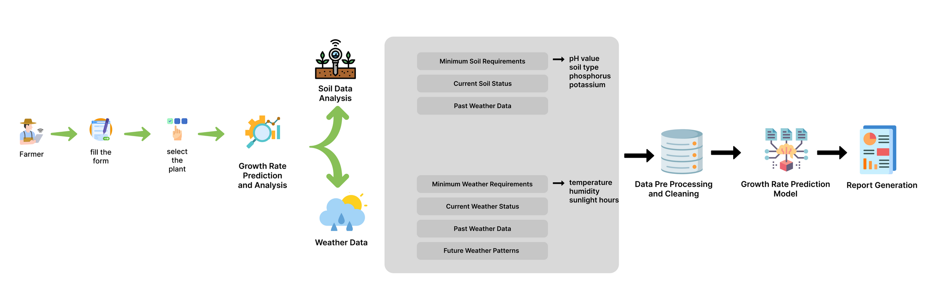
System Diagram
Sewwandi P B | IT21172632 | 24-25J-193

Slide 38
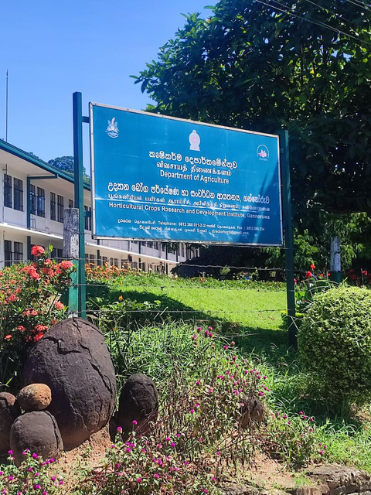
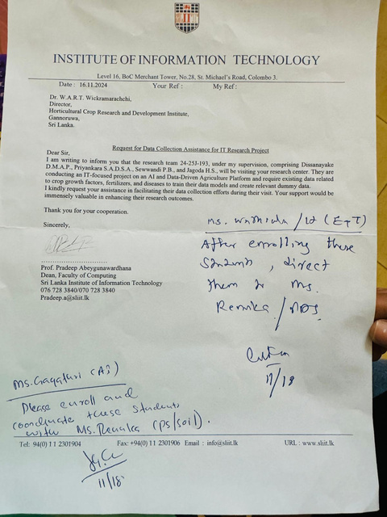
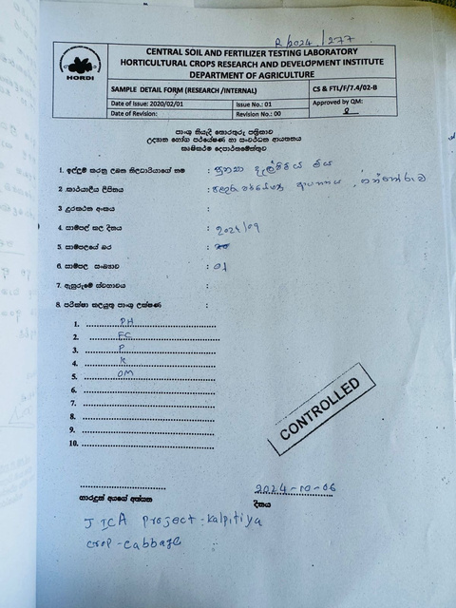
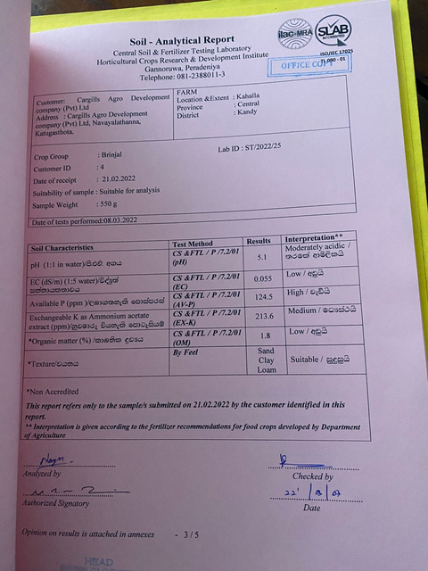
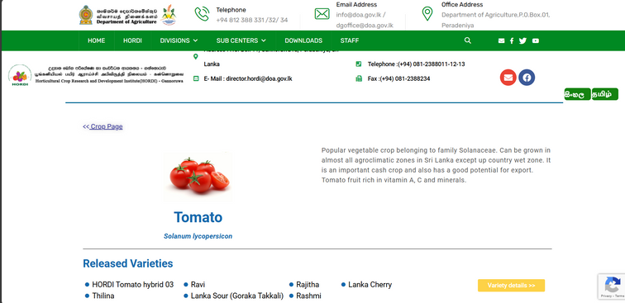
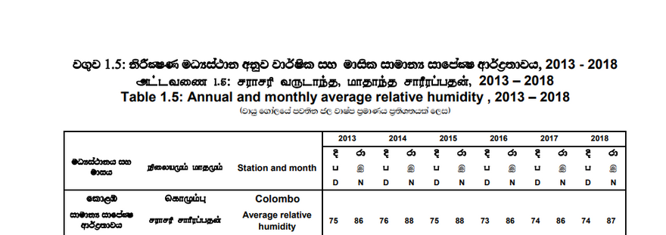
Data Collection
Sewwandi P B | IT21172632 | 24-25J-193

Slide 39
Demonstration
Sewwandi P B | IT21172632 | 24-25J-193

Slide 40
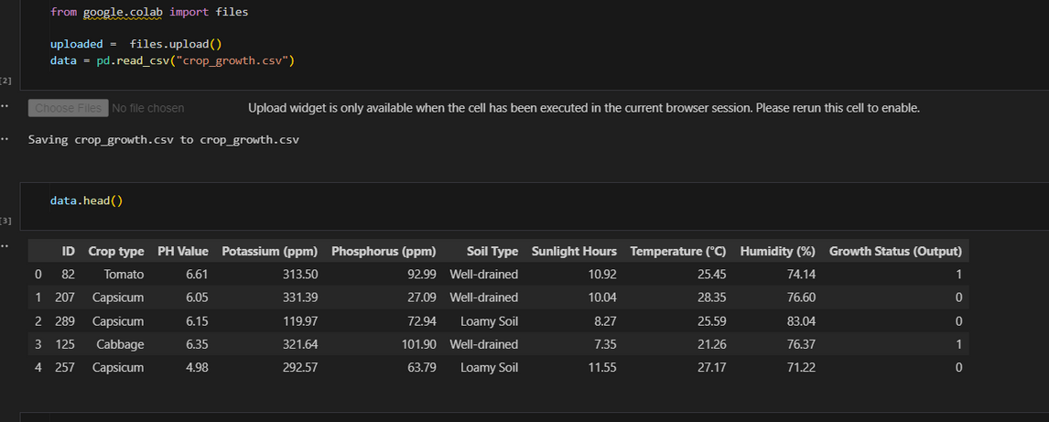
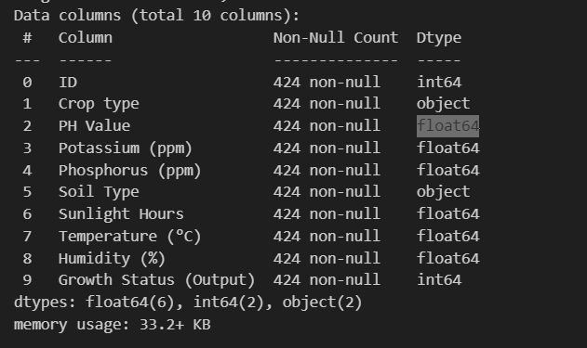
Data Set
Sewwandi P B | IT21172632 | 24-25J-193

Slide 41
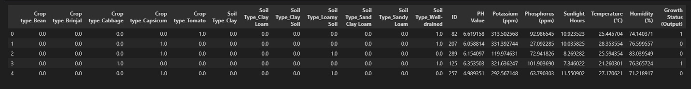
Data Preparation
One hot encoding
Sewwandi P B | IT21172632 | 24-25J-193

Slide 42
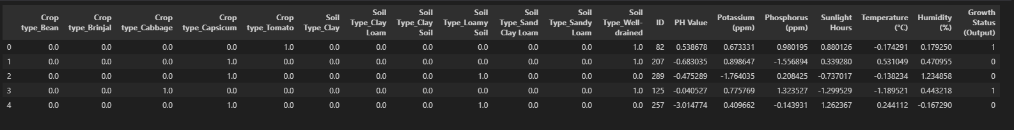
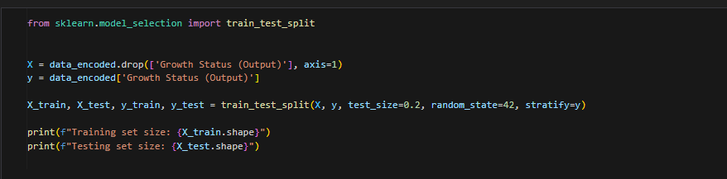
Data Preparation
Feature Scaling
split the data set
Sewwandi P B | IT21172632 | 24-25J-193

Slide 43
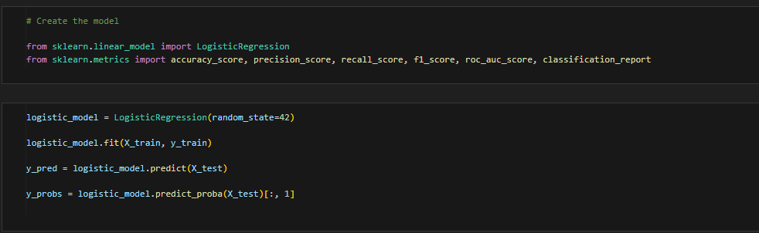
Model Creation and Training
Sewwandi P B | IT21172632 | 24-25J-193

Slide 44
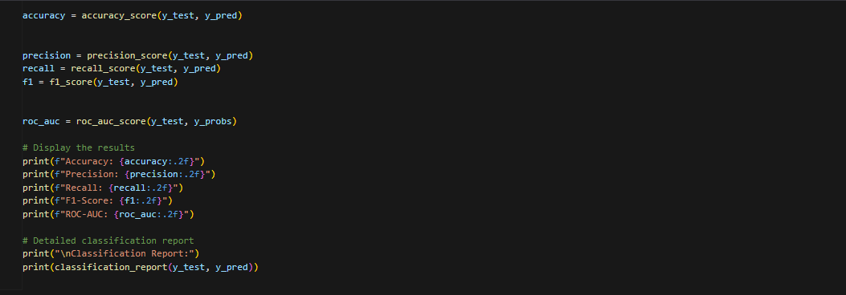
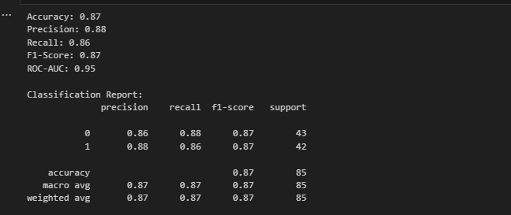
Model Performance and Comparison
Sewwandi P B | IT21172632 | 24-25J-193

Slide 45
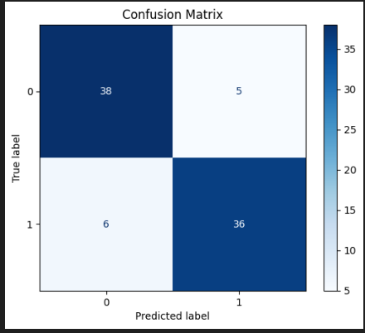
Model Performance and Comparison contd.
Sewwandi P B | IT21172632 | 24-25J-193

Slide 46
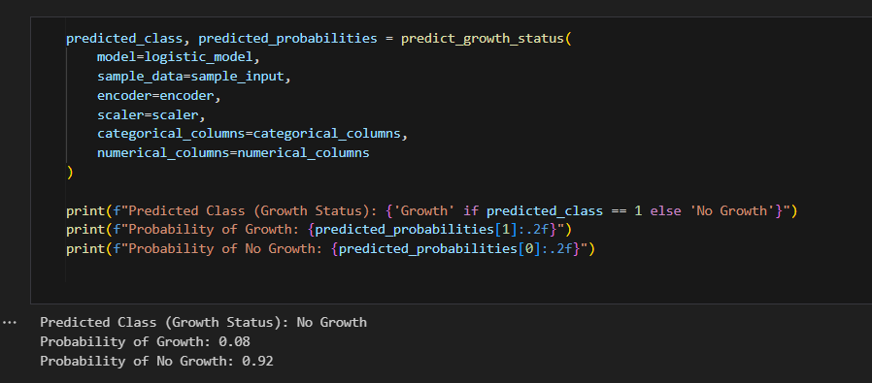
Testing
Sewwandi P B | IT21172632 | 24-25J-193

Slide 47
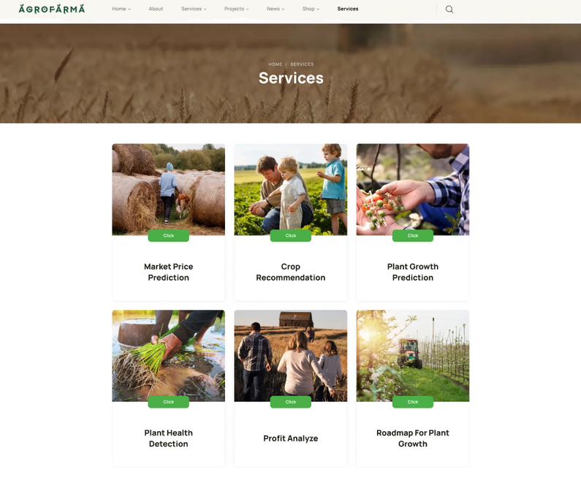
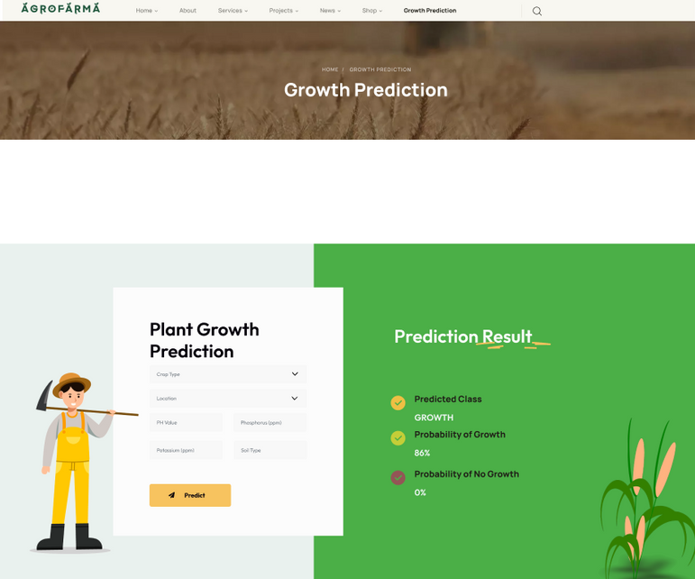
Wire Frames and UIs
Sewwandi P B | IT21172632 | 24-25J-193

Slide 48

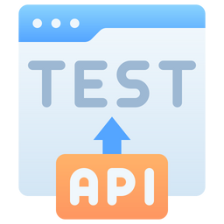



Tasks To Be Done
Creating UIs
API Testing
Frontend
connectivity
Usability Testing
Sewwandi P B | IT21172632 | 24-25J-193

Slide 49
Technologies to be Used
Growth Rate Prediction
Machine Learning Algorithms: Logistic Regression, A and Supervised ML models for accurate growth rate predictions.
Data Sources: Real-time weather data using Weather APIs.
Web Application
Tech Stack: MERN stack (MongoDB, Express, React, Node.js) for building a user-friendly interface.
Backend Framework: Flask for managing server-side logic.
Databases: Firebase for real-time data management
Data Visualization
Tools: Power BI for presenting data insights in a comprehensible and interactive manner.
Sewwandi P B | IT21172632 | 24-25J-193

Slide 50
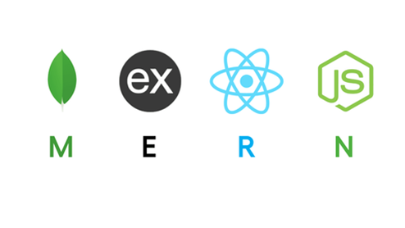






Tools and Technologies
Programming Languages: Python , MERN stack , flask
APIs : Weather APIs (Google Cloud Vision API)
Databases: Firebase for real-time data management
Data Visualization : Power BI
Sewwandi P B | IT21172632 | 24-25J-193

Slide 51
References
[1] Researchgate.net. [Online]. Available: https://www.researchgate.net/publication/348020414_Crop_Yield_Prediction_Using_Machine_Learning_Techniques. [Accessed: 12-Aug-2024].
[2]R. Gunasekara, H. Withanage, N. Wimalachandra, L. Hettiarachchi, B. Attanayaka, and S. Thelijjagoda, “Expert prediction system for spice plants grown in Sri Lanka: An incentive for planters,” in 2021 IEEE 16th International Conference on Industrial and Information Systems (ICIIS), 2021, pp. 86–91.
[3] Researchgate.net. [Online]. Available: https://www.researchgate.net/publication/356826715_Smart_Agriculture_Prediction_System_for_Vegetables_Grown_in_Sri_Lanka. [Accessed: 12-Aug-2024].
[4]H. Sajindra, T. Abekoon, J. A. D. C. A. Jayakody, and U. Rathnayake, “A novel deep learning model to predict the soil nutrient levels (N, P, and K) in cabbage cultivation,” Smart Agricultural Technology, vol. 7, no. 100395, p. 100395, 2024.
Sewwandi P B | IT21172632 | 24-25J-193

Slide 52
Component 04
Jagoda H S
IT21174926
CropWise
Decision Support System for Crop Recommendation
Jagoda H S | IT21174926 | 24-25J-193

Slide 53
Introduction
At the end of every harvest, the farmer must decide which crops he is going to grow for the next season. Most of them are used to growing crops based on either tradition or intuition.
While this may be effective to a certain extent, it does not:
Capitalize on the potential of the land.
Optimize the yield of each harvest.
Maximize the profit gained by the farmer.
Jagoda H S | IT21174926 | 24-25J-193

Slide 54
Problem
Overreliance on a single crop
Suboptimal Crop Yield
Soil Degradation
Market Price Fluctuations
Jagoda H S | IT21174926 | 24-25J-193

Slide 55


Research Gap
 | Research [1] | Research [2] | Research [3] | AGROFARMA
Soil & Land data Variables
Weather Integration
Considers Crop Rotation Principles
Yield Predictions
Jagoda H S | IT21174926 | 24-25J-193

Slide 56


Research Gap
 | Research [1] | Research [7] | Research [11] | Research [6] | AGROFARMA
Growth Suitability Prediction
Weather Integration
Soil Parameter Analysis
Data-Driven Recommendations
Web Application Implementation
Jagoda H S | IT21174926 | 24-25J-193

Slide 57
Objectives
Empowering the farmer with the ability to make informed decisions regarding the next rotation of crops he will be growing.
Determining the most suitable crop(s) to be grown under the available conditions.
Predicting the yield of the selected crops.
Comparing the potential yield and market price for the crops in the coming season.
Providing detailed overview of the best options to be planted.
Jagoda H S | IT21174926 | 24-25J-193

Slide 58



System Diagram
Crops Database
Predicted Weather
List of Crops
Required weather conditions to grow
Required soil conditions to grow
Soil Condition
Last Crop Grown by User
Select crops suitable to be grown in the expected condition
Historical Data
Market Rates
Yield
Machine Learning Model
Display Best Potential Crops to be planted
+ crops to avoid
Jagoda H S | IT21174926 | 24-25J-193

Slide 59
Requirements
Functional Requirements
Non-functional requirements
Crop database
User Interface
Weather API Integration
Historical Data Usage
Machine Learning Model
Crop Rotation Recommendation
Performance
Usability
Accuracy
Compatibility
Jagoda H S | IT21174926 | 24-25J-193

Slide 60





Tools and Technologies
Jagoda H S | IT21174926 | 24-25J-193

Slide 61
References
[1]
K. Y. Maksimovich, V. K. Kalichkin, D. S. Fedorov, and V. V. Aleschenko, "Application of machine learning methods for crop rotation selection in organic farming system," in E3S Web Conf., vol. 486, p. 01028, 2024. DOI: 10.1051/e3sconf/202448601028.
[2]
K. P. S. M. Nandasiri, S. Jayasinghe, K. Banujan, E. M. U. W. J. B. Ekanayake, B. T. G. S. Kumara, and P. Senthan, "A machine learning influenced recommendation system for predicting the rainfall and price for crops in Badulla District," in Proc. Int. Conf. Adv. Technol. Comput. (ICATC-2022), Faculty of Computing and Technology, Univ. of Kelaniya, Sri Lanka, Dec. 2022.
[3]
T. H. Ruchirawya, W. J. M. Nanayakkara, D. M. A. C. Dimantha, P. M. G. Pabasara, P. Bandara, and T. Weerasooriya, "Crop Recommendation System," International Journal of Computer Applications, vol. 175, no. 22, Oct. 2020.
Jagoda H S | IT21174926 | 24-25J-193

Slide 62
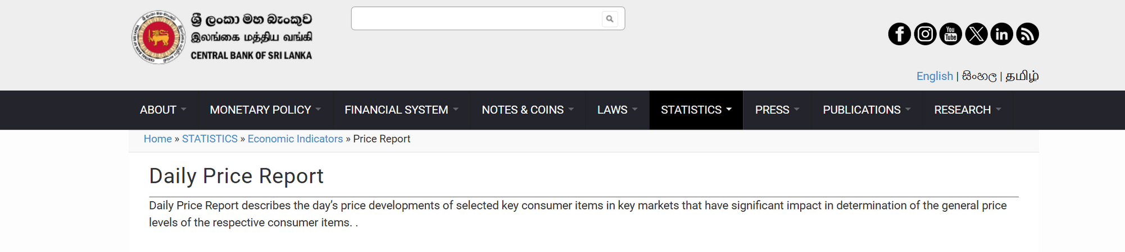
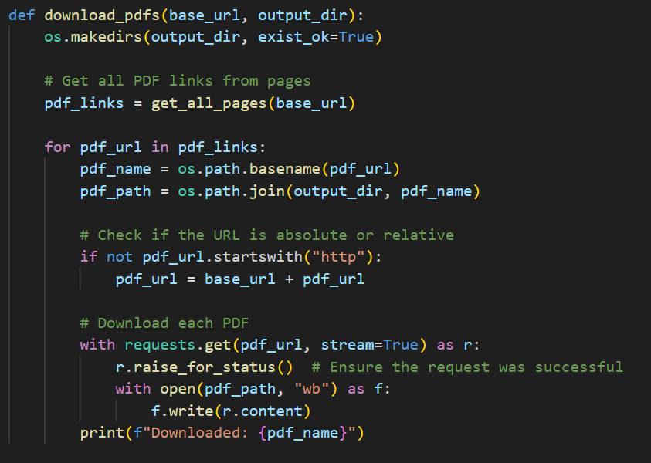

Data Collection
Price Reports
https://www.cbsl.gov.lk/en/statistics/economic-indicators/price-report
PDF files from 2017 - 2024 downloaded
Table data extracted using camelot library
Crop Growth and Soil Related Data
Reports from Horticultural Crop Growth & Development Institute (2022 - 2023)
Jagoda H S | IT21174926 | 24-25J-193

Slide 63


Data Set
Jagoda H S | IT21174926 | 24-25J-193

Slide 64


Data Set (ctnd..)
Jagoda H S | IT21174926 | 24-25J-193

Slide 65

Data Preparation
Random Forest Regression
Jagoda H S | IT21174926 | 24-25J-193

Slide 66

Data Preparation
Gradient Boosting Regressor
Jagoda H S | IT21174926 | 24-25J-193

Slide 67

Model Creation and Training
Random Forest Regression
Jagoda H S | IT21174926 | 24-25J-193

Slide 68

Model Creation and Training
Gradient Boosting Regressor
Jagoda H S | IT21174926 | 24-25J-193

Slide 69

Wire Frames and UIs
Jagoda H S | IT21174926 | 24-25J-193

Slide 70

Wire Frames and UIs
Jagoda H S | IT21174926 | 24-25J-193

Slide 71
Demonstration
Jagoda H S | IT21174926 | 24-25J-193

Slide 72
Component 04
Dissanayake D M A P
IT21158490
Personalized Agri Assistant
Dissanayake D M A P | IT21172632 | 24-25J-193

Slide 73
Introduction
Agri Assistant is a pivotal component designed to empower farmers with real-time, personalized agricultural advice. It combines a roadmap for optimized crop growth, deep learning-based image processing to monitor plant health, and an interactive chat feature for instant agricultural support. This system aims to enhance decision-making, improve crop yield, and promote sustainable farming practices
Dissanayake D M A P | IT21172632 | 24-25J-193

Slide 74
Problem
Farmers often struggle with managing crop health and making timely decisions due to a lack of tailored guidance and real-time support. Traditional methods for diagnosing plant issues are often inadequate, leading to reduced crop yields and increased vulnerability to environmental and pest-related challenges.
Dissanayake D M A P | IT21172632 | 24-25J-193

Slide 75

System Diagram
Dissanayake D M A P | IT21172632 | 24-25J-193

Slide 76







Tools and Technologies
Programming Languages: Python, TensorFlow, Keras
APIs: Google Cloud Vision API, Twilio for Chat Integration
Databases: Firebase for real-time data management
Development Tools: Jupyter Notebooks, VS Code, Git for version control
Dissanayake D M A P | IT21172632 | 24-25J-193

Slide 77
References
1. Casa, A. de la, Ovando, G., & Díaz, G. (2021). Linking data of ENSO, NDVI-MODIS and crops yield as a base of an early warning system for agriculture in Córdoba, Argentina. Remote Sensing Applications Society and Environment, 22(100480), 100480. Add a little bit of body text
2. (N.d.). Researchgate.net. Retrieved August 14, 2024, from Add a little bit of body text
3. Mana, A. A., Allouhi, A., Hamrani, A., Rehman, S., el Jamaoui, I., & Jayachandran, K. (2024). Sustainable AI-based production agriculture: Exploring AI applications and implications in agricultural practices. Smart Agricultural Technology, 7(100416), 100416. Add a little bit of body text
4. Padhiary, M., Saha, D., Kumar, R., Sethi, L. N., & Kumar, A. (2024). Enhancing precision agriculture: A comprehensive review of machine learning and AI vision applications in all-terrain vehicle for farm automation. Smart Agricultural Technology, 8(100483), 100483. Add a little bit of body text
5.Helfer, G. A., Victória Barbosa, J. L., Santos, R. dos, & da Costa, A. B. (2020). A computational model for soil fertility prediction in ubiquitous agriculture. Computers and Electronics in Agriculture, 175(105602), 105602. Add a little bit of body text
6. Preite, L., & Vignali, G. (2024). Artificial intelligence to optimize water consumption in agriculture: A predictive algorithm-based irrigation management system. Computers and Electronics in Agriculture, 223(109126), 109126. https://doi.org/10.1016/j.compag.2024.109126
7. Nguyen, B. T., Shin, E.-J., Jeong, J. H., Sharma, N., Tran, N. K. C., Nguyen, Y. N. D., Kim, D.-J., Wie, M. B., Lee, Y., Byun, J. K., Ko, S. K., Nah, S.-Y., & Kim, H.-C. (2023). Mountain-cultivated ginseng protects against cognitive impairments in aged GPx-1 knockout mice via activation of Nrf2/ChAT/ERK signaling pathway. Journal of Ginseng Research, 47(4), 561–571. https://doi.org/10.1016/j.jgr.2023.01.005
8. (N.d.). Researchgate.net. Retrieved August 14, 2024, from https://www.researchgate.net/publication/340281012_E-AGRO_Intelligent_Chat-Bot_IoT_and_Artificial_Intelligence_to_Enhance_Farming_Industry
9. Nguyen, B. T., Shin, E.-J., Jeong, J. H., Sharma, N., Tran, N. K. C., Nguyen, Y. N. D., Kim, D.-J., Wie, M. B., Lee, Y., Byun, J. K., Ko, S. K., Nah, S.-Y., & Kim, H.-C. (2023). Mountain-cultivated ginseng protects against cognitive impairments in aged GPx-1 knockout mice via activation of Nrf2/ChAT/ERK signaling pathway. Journal of Ginseng Research, 47(4), 561–571. https://doi.org/10.1016/j.jgr.2023.01.005
Dissanayake D M A P | IT21172632 | 24-25J-193

Slide 78

Data Collection
this data set is used for the current running model. thai is help to predict Tomato plant diseases accurately. THis is publicly available on kaggle.com
https://www.kaggle.com/datasets/arjuntejaswi/plant-village
Dissanayake D M A P | IT21172632 | 24-25J-193

Slide 79


Data Set
This is the dataset that I used to train and test my model. this included 16,011 images for the training and testing purpose.
Dissanayake D M A P | IT21172632 | 24-25J-193

Slide 80

Data Preparation
Preprocessing
Normalizing
Splitting
Training
Testing
Validation
Dissanayake D M A P | IT21172632 | 24-25J-193

Slide 81


Model Creation
Dissanayake D M A P | IT21172632 | 24-25J-193

Slide 82


Model Training
Dissanayake D M A P | IT21172632 | 24-25J-193

Slide 83


Model Performance and Comparison
Dissanayake D M A P | IT21172632 | 24-25J-193

Slide 84


User Interfaces
Plant Roadmap
Image Details
Tomato
Disease Name : ABC
Week One
Fertilizer
How to Use?
Dissanayake D M A P | IT21172632 | 24-25J-193

Slide 85
COMMERCIALIZATION
Basic
Gold
Premium
Access to basic crop market price predictions
Basic soil moisture reporting for a single plot
Limited to 5 package generations per month
Email support
Access to advanced crop market price predictions with additional parameters
Detailed soil moisture reporting for up to 3 plots
Unlimited package generations
Success rate predictions
Access to alternative crop suggestions based on market conditions
Priority email support and live chat
Full access to all market price prediction models, including ARIMA, BP network, and RNN
Comprehensive soil moisture and health reports for up to 5 plots
Unlimited package generations with priority processing
Success rate predictions and personalized recommendations
AI chatbot support for 24/7 assistance with farming queries
FREE
9$ PER MONTH
15$ PER MONTH

Slide 86

Thank You!
Dissanayake D M A P | Priyankara S A D S A | Sewwandi P B | Jagoda H S | 24-25J-193

Slide 87
Any Questions ?

